Slide 1

Il perioperatorio:
ERAS in chirurgia di parete
Ugo BARDI
Delegato Regionale Campania POIS – ERAS Italian Chapter
Unità di Chirurgia Generale e Laparoscopica Avanzata
Centro di Eccellenza S.I.C.OB.
Casa di Cura Privata ‘’SALUS’’ – Battipaglia (SA)

Slide 2

ERAS
ERAS contributes to improved patient outcomes, reduces postoperative complications, accelerates recovery, and supports early discharge, with savings from decreased length of stay, complications and readmission offsetting increased cost of care
The key elements of ERAS include patient/family education, patient optimization prior to admission, minimal fasting that optimally includes a carbohydrate beverage and at a minimum clear fluids up until 2 hours before anesthesia, multimodal analgesia with appropriate use of opioids when indicated, return to normal diet and activities the day of surgery, and return home
Preoperative phase
Postoperative phase
Paton F et al. Effectiveness and implementation of enhanced recovery after surgery programmes: a rapid evidence synthesis. BMJ Open. 2014

Slide 3



Differenziazione dell’offerta chirurgica
Ricovero ordinario tradizionale
Week Surgery
Day Surgery/One Day Surgery
Chirurgia ambulatoriale complessa
Chirurgia ambulatoriale
PACC
(PERCORSI AMBULATORIALI COMPLESSI e COORDINATI)
Foto cicatelli
Giunta Regionale - Seduta del 23 gennaio 2009 - Deliberazione N. 102 - Area Generale di Coordinamento N. 20 - Assistenza Sanitaria
The European Hernia Society has published a grade B (“weakly positive”) recommendation that all patients candidate for inguinal and femoral hernia repair, can be considered potentially eligible for day surgery
Simons MP et al. Hernia. (2009) 13:343–403

Slide 4


Day Surgery/One Day Surgery/
PACC
ERAS

Slide 5
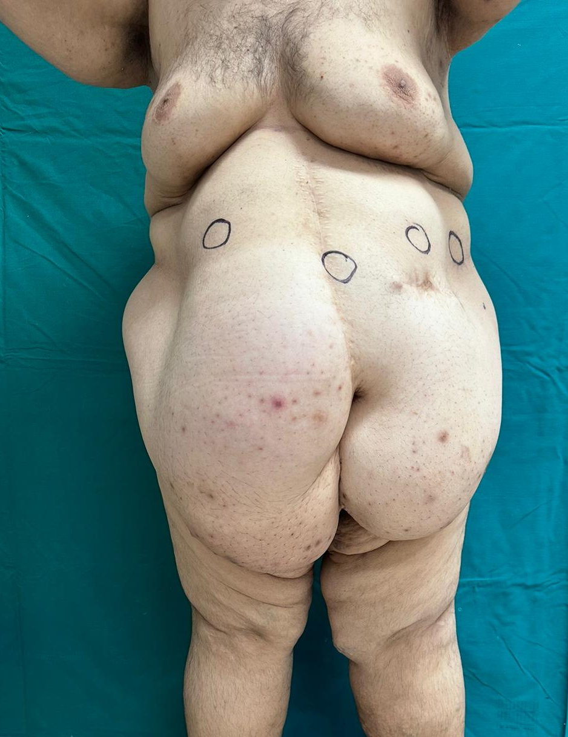
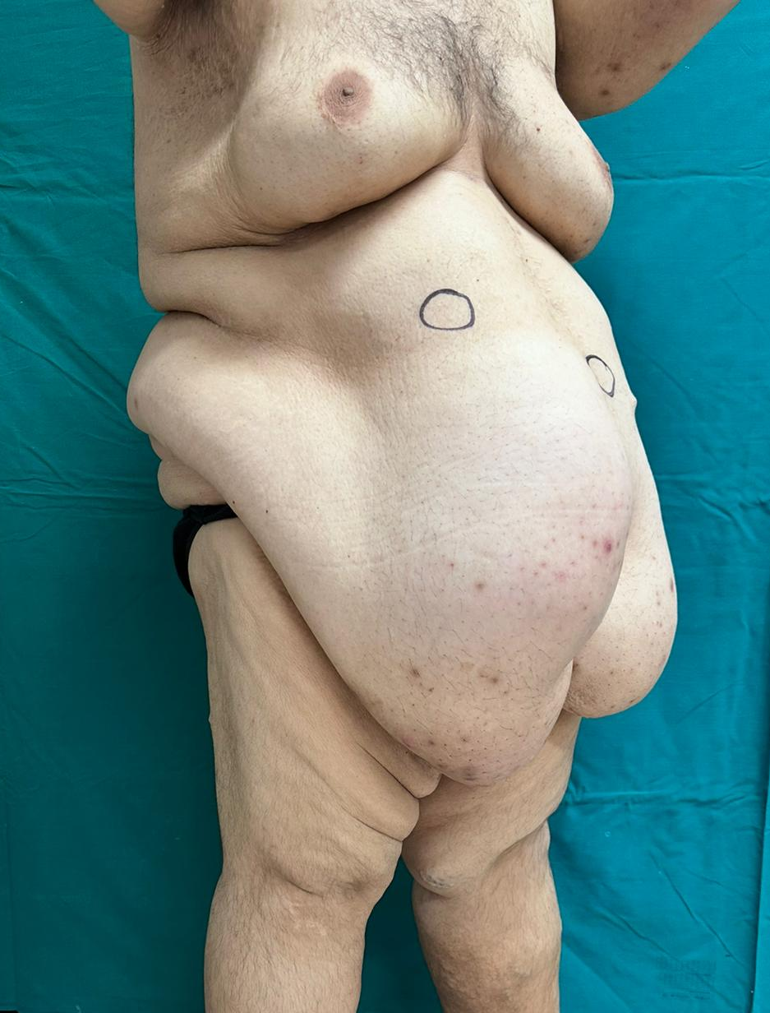
Pz: C.D. Anni: 38
BMI: 63,6 Kg/m² Peso attuale: 173 Kg
COMORBIDITA’:
A.P.R.:
Pregressa chirurgia:
A.P.P.:
Ipertensione arteriosa, dislipidemia
Peritonite da diverticolite acuta complicata da perforazione
Resezione sec. Hartmann con confezionamento di colostomia temporanea in FS (2018)
Ricanalizzazione con chiusura di colostomia (2019)
Posizionamento di BIB (Maggio 2023) (BMI: 76 Kg/m² – Peso: 207 Kg)
Rimozione BIB per rottura (Ottobre 2023)
Obesità patologica, laparocele mediano (porta di circa 10 cm a contenuto intestinale)

Slide 6
Fattori legati al paziente
Età > 70 anni
BMI > 30 Kg/m²
ASA score > II
Comorbidità:
Patologie cardiovascolari (es. Ipertensione arteriosa)
Patologie respiratorie (es. BPCO)
Diatesi emorragica
Insufficienza renale
Insufficienza epatica
Fattori legati alla chirurgia
Dimensioni del difetto: Diametro Max > 10 cm
Contenuto erniario
Tipologia di chirurgica (Tecnica di riparazione/azioni concomitanti)

Slide 7


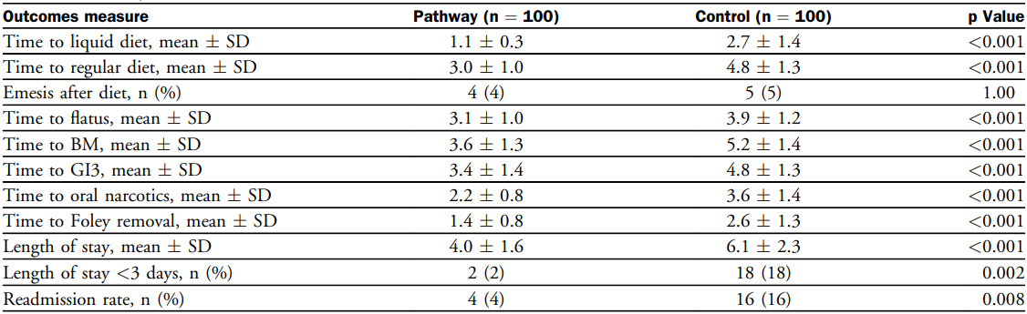
Complex hernia patients present formidable challenges to the surgeon, not only in the operating room, but also during perioperative management
The study demonstrates that implementation of ERAS pathway has resulted in accelerated intestinal recovery, reduced length of stay, and improved readmission rate
Majumder A et al. J Am Coll Surg. (2016) 222(6):1106-15

Slide 8

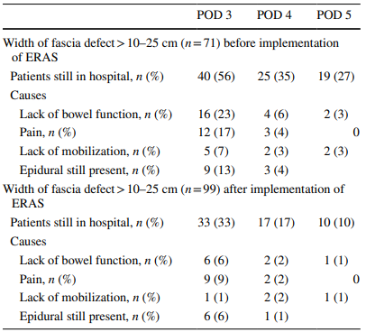
Pain, lack of mobilization, and lack of bowel function were the most common causes of prolonged hospitalization after OIHR
Lack of bowel function was reduced after ERAS implementation
Lack of mobilization was reduced after ERAS implementation
Conclusions: ERAS implementation led to a reduction of LOS
Skovgaard DM et al. Ernia. (2021) 25(4):1027-1034

Slide 9

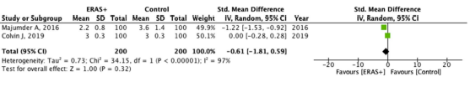

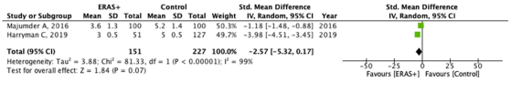

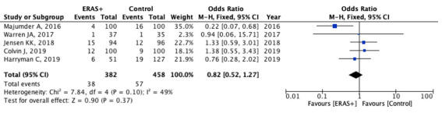
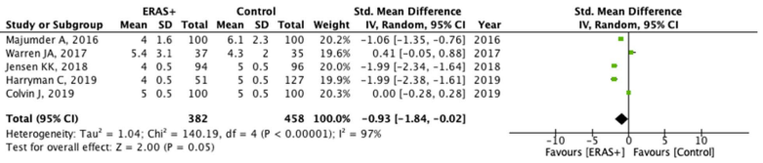
Time to discontinuation of narcotics
Time to Foley removal
Time to return to bowel function
Time to return to regular diet
Readmission
Length of hospital stay
There were no statistically significant differences between the ERAS and Control groups regarding the time to discontinuation of narcotics, time to urinary catheter (Foley) removal, time to return to regular diet, and readmission rate
Length of hospital stay was significantly shorter in the ERAS + compared to the Control group
Sartori A et al. Ernia. (2021) 25(2):501-521

Slide 10
FROM COLORECRAL SURGERY
TO GENERAL SURGERY
PHYSICAL FITNESS
NUTRITIONAL STATUS
PSYCHOLOGICAL SUPPORT

Slide 11

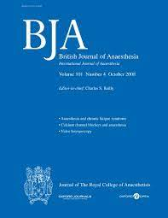

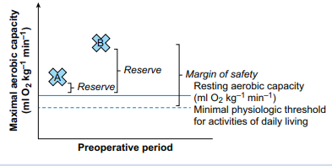
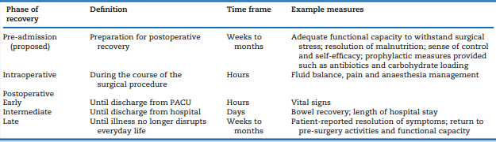
PREHABILITATION
Low performance ꓿ High risk!
Gillis C et al. British Journal of Anaesthesia. 2022. 128 (3): 434e448
Notes:
Le prestazioni cardiorespiratorie contribuiscono a una capacità fisiologica - definita come la capacità di organi e sistemi biologici per funzionare sotto stress. Senza un'adeguata capacità cardiorespiratoria per sostenere la risposta fisiologica allo stress, un paziente potrebbe non essere in grado di soddisfare le esigenze aggiuntive della chirurgia e potrebbe sperimentare scarsi risultati chirurgici di conseguenza. La capacità di esercizio rappresenta quindi un margine di sicurezza che non è solo protettivo contro lo sviluppo di complicanze postoperatorie, ma fornisce anche protezione contro lo sviluppo di future menomazioni funzionali

Slide 12
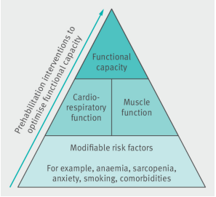
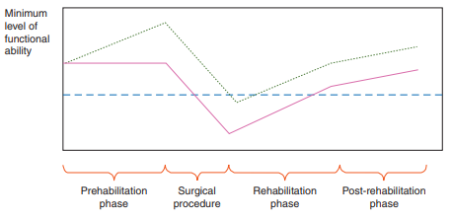

PREHABILITATION’S ELEMENTS
Medical optimization of pre-exinting conditions
Physical fitness
Nutritional status
Psychological support
These interventions are provided by a multidisciplinary team consisting of surgeons, anaesthetists, physicians, geriatricians, physiotherapists, nutritionists, and psychologists
Banugo P et al. Prehabilitation. BJA Education, 17 (12): 401–405 (2017)

Slide 13





MEDICAL OPTIMIZATION OF PRE-EXINTING
CONDITIONS
Prehabilitation involves a preliminary screening and assessment of the patient’s physical, nutritional, and psychological qualities, followed by a structured and personalized multidisciplinary program started at least 4–5 weeks before surgery and requires the collaboration of surgeons, anesthesiologists, internists, family doctors, nurses, physiotherapists, nutritionists, kinesiologists, and psychologists
Correzione dell’anemia

Slide 14
PREHABILITATION’S ELEMENTS
Medical optimization of pre-exinting conditions
Physical fitness
Nutritional status
Psychological support

Slide 15


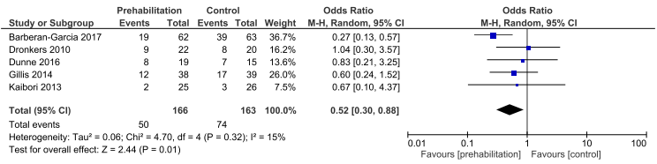
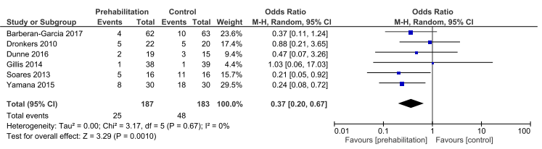
PHYSICAL EXERCISE
Meta-analysis showed a significant reduction in overall postoperative complications in the prehabilitation group compared with the controls
The prehabilitation sessions included aerobic training in various modes (ergometer or walking)
Significantly lower pulmonary complication rate after prehabilitation
Heger P et al. J Gastrointest Surg. 2020 Jun;24(6):1375-1385

Slide 16
PREHABILITATION’S ELEMENTS
Medical optimization of pre-exinting conditions
Physical fitness
Nutritional status
Psychological support

Slide 17
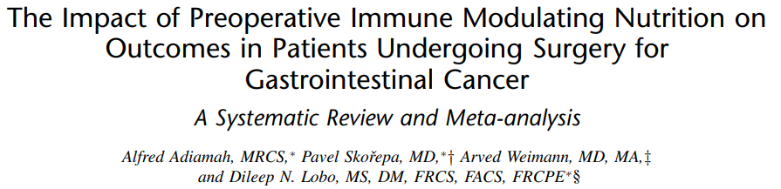
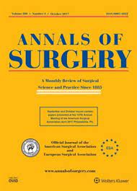
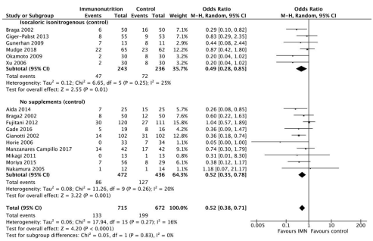
NUTRITIONAL STATUS
Preoperative IMN reduces the risk of developing infectious complications after surgery for gastrointestinal cancer
A minimum of 5 to 7 days would be optimal for the intended benefits of IMN on outcomes
Preoperative administration of IMN did not impact mortality
Adiamah A. et al. Ann Surg. 2019 Aug;270(2):247-256

Slide 18

NUTRITIONAL STATUS
Arginina, Omega 3, RNA e fibra solubile
Proteine 22%; Lipidi 25%; Carboidrati 53%
237 mL ≈ 341 Kcal
3 brik/die per 5/15 gg preop
Very low calories diet (VLCD)
Very low calories ketogenic diets (VLCKD)
Pharmacologic treatment
A modest weight loss of 5-10% in the immediate preoperative period could facilitate surgery and reduce the risk of complications

Slide 19

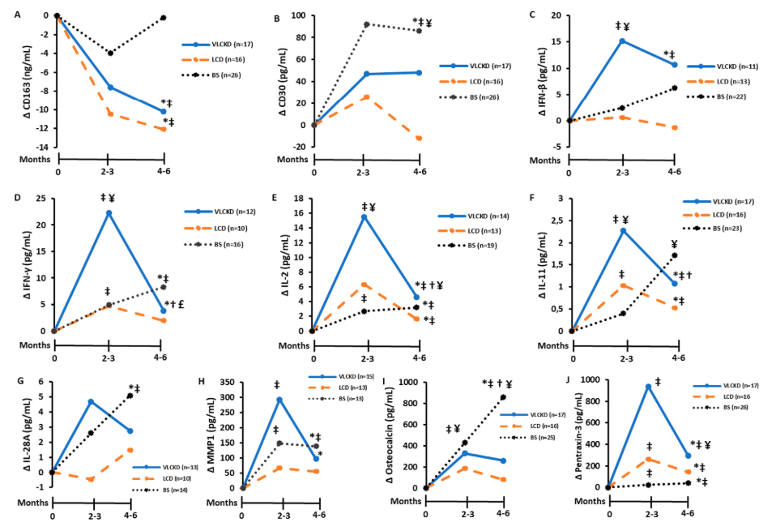
NUTRITIONAL STATUS
When patients with obesity underwent energy-restricted or surgical weight loss strategies, inflammatory and oxidative stress biomarkers are improved
The effect was more notable in patients following the VLCKD
Ketone bodies production induced by this ketogenic diet could be the main factor associated with the improvement in the inflammation
Lorenzo PM et al. (2022) Clinical Nutrition. 41 1566e1577

Slide 20
PREHABILITATION’S ELEMENTS
Medical optimization of pre-exinting conditions
Physical fitness
Nutritional status
Psychological support

Slide 21



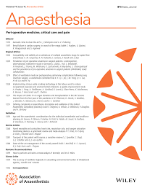

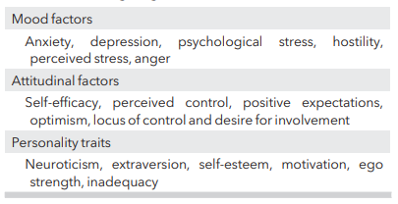
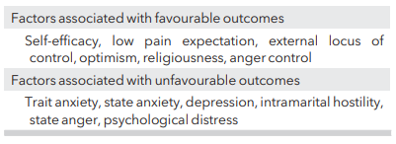
PSYCHOLOGICAL SUPPORT
After surgery, many patients experience “postoperative fatigue,” a frustrating sensation typically described as involving tiredness, lethargy, sluggishness, changed emotional state, and a desire to sleep or rest more
Two elements that may be particularly important in regulating activity after surgery are a patient’s interpretation of the medical advice they receive and their interpretation of what their symptoms signify
Many studies have identified strong correlations between negative mood and postoperative fatigue
Pre-operative psychological factors addressing surgical outcomes
Psychological factors associated with positive and negative short-term surgical outcomes
Psychological interventions can improve outcome?
Levett D.Z.H. et al. Anaesthesia 2019, 74

Slide 22

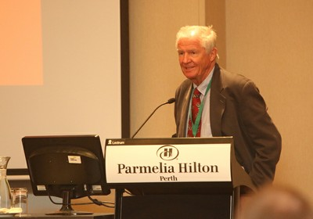
BUT WHAT IS THE ORIGIN OF ERAS?
Enhanced Recovery After Surgery (ERAS) is a new surgery protocol that streamlines patient processes before, during and after surgeries
ERAS refers to patient-centered, evidence-based, interdisciplinary team developed pathways for a surgical specialty and facility culture to reduce the patient’s surgical stress response, optimize their physiologic function, and facilitate recovery
“STRESS FREE ANAESTHESIA AND SURGERY”
Kenhelt 1997

Slide 23

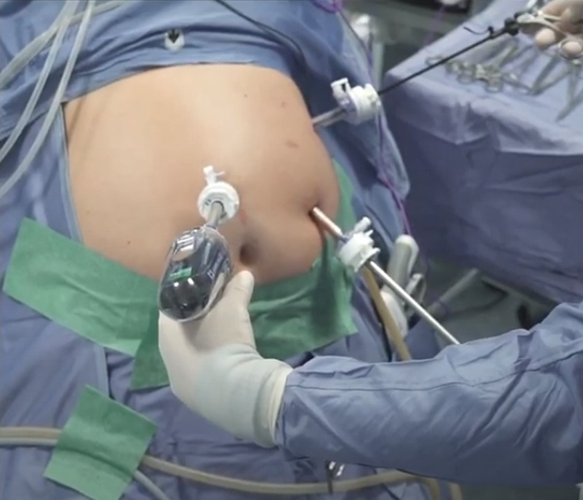
Standardized
anesthesiological protocol
But also…
Standardized
surgical technique

Slide 24
CONCLUSIONI
ERAS racchiude un concetto dinamico, che necessita di un continuo monitoraggio di applicazione
Il protocollo ERAS è sicuro ed efficace
Si raccomanda l’adesione al protocollo ERAS
ERAS comprende tutte quelle azioni e/o procedure volte a migliorare sia lo stato generale che immunologico del paziente
Il chirurgo è coinvolto nella maggioranza degli item del protocollo ERAS
La letteratura sottolinea come sia discrezione del chirurgo valutare o meno la necessità di applicare i vari item del protocollo sulla base dei rischi chirurgici intercorrenti
Aderire a pochi item del protocollo ERAS non significa non essere ERAS!!!
L’adesione a tutti gli item del protocollo ERAS deve avvenire in maniera progressiva
La salute e la sicurezza del paziente devono sempre essere messe al primo posto

Slide 25


II Edition
Maggio 2024

Slide 26
Grazie per l’attenzione

